Slide 1
SemEval2019 Task3

Slide 2
Dataset
Train: 30160 samples
Dev: 2755 samples
id | turn1 | turn2 | turn3 | label
0 | Don't worry I'm girl | hmm how do I know if you are | What's ur name? | others
1 | When did I? | saw many times i think -_- | No. I never saw you | angry
2 | By | by Google Chrome | Where you live | others
13 | Bad | Bad bad! That's the bad kind of bad. | I have no gf | sad
28 | You are very funny | so I've been told | India | happy
Label | # of Samples
Happy | 4243
Angry | 5506
Sad | 5463
Others | 14948
id | turn1 | turn2 | turn3
0 | Then dont ask me | YOURE A GUY NOT AS IF YOU WOULD UNDERSTAND | IM NOT A GUY FUCK OFF
1 | Mixed things such as?? | the things you do. | Have you seen minions??
2 | Today I'm very happy | and I'm happy for you ❤ | I will be marry
3 | Woah bring me some | left it there oops | Brb

Slide 3
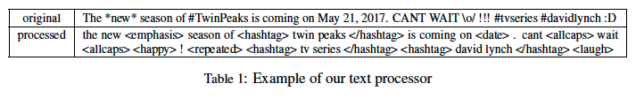
Preprocess
Utilize the ekphrasis2 (Baziotis et al., 2017) tool as a tweet preprocessor
http://github.com/cbaziotis/ekphrasis
The preprocessing steps included in ekphrasis are
Twitter-specific tokenization
spell correction
word normalization (e.g. #TwinPeaks → <hashtag> )
word segmentation (for splitting hashtags)
word annotation

Slide 4
Embedding
word2vec-GoogleNews-vectors
pre-trained Google News corpus word vector model
Corpus size: 3 billion running words
Vocab size: 3 million
Dimension: 300
https://drive.google.com/file/d/0B7XkCwpI5KDYNlNUTTlSS21pQmM/edit
NTUA
pre-trained twitter word vector model
Corpus preprocessed by: Ekphrasis
Corpus size: 550M
Dimension: 300
Vocab size: 804870
Word2vec training parameters: window_size = 6, negative_sampling = 5, min_count = 20
https://drive.google.com/file/d/1b-w7xf0d4zFmVoe9kipBHUwfoefFvU2t/view

Slide 5
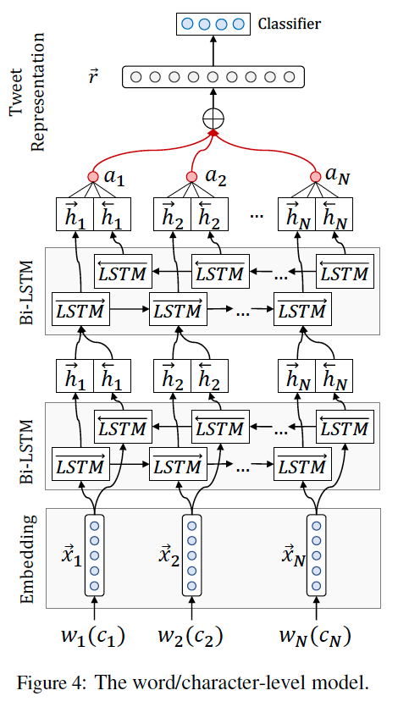
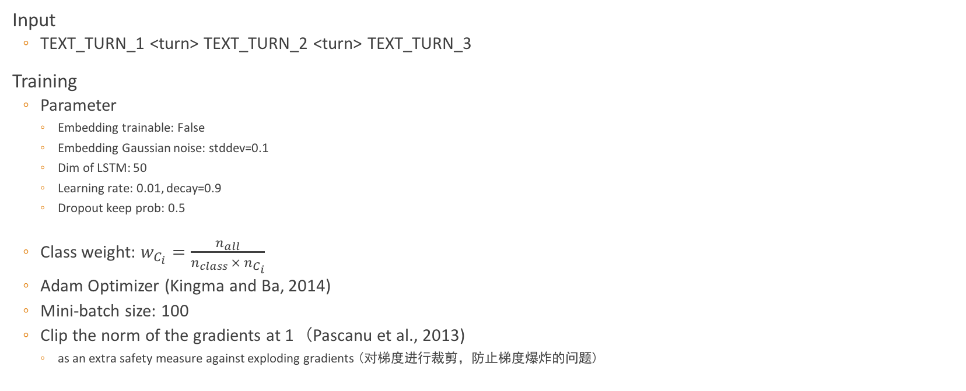
Model
Input
TEXT_TURN_1 <turn> TEXT_TURN_2 <turn> TEXT_TURN_3
Training
Parameter
Embedding trainable: False
Embedding Gaussian noise: stddev=0.1
Dim of LSTM: 50
Learning rate: 0.01, decay=0.9
Dropout keep prob: 0.5
Class weight: $w_{C_{i}}=\frac{n_{all}}{n_{class} × n_{C_{i}}}$
Adam Optimizer (Kingma and Ba, 2014)
Mini-batch size: 100
Clip the norm of the gradients at 1 (Pascanu et al., 2013)
as an extra safety measure against exploding gradients (对梯度进行裁剪，防止梯度爆炸的问题)

Slide 6
Evaluation
Data distribution
Training data consists of about 5k samples each from 'angry', 'sad', 'happy' class, and 15k samples from 'others' class
Both Dev and Test sets have a real life distribution, which is about 4% each of 'angry', 'sad', 'happy' class and the rest is 'others' class
Metric
Micro-averaged F1-score for the three emotion classes i.e. Happy, Sad and Angry
Pµ = ΣTPi / Σ(TPi + FPi)∀i {Happy,Sad,Angry}
Rµ = ΣTPi / Σ(TPi + FNi)∀i {Happy,Sad,Angry}
TPi is the number of samples of class i which are correctly predicted
FNi and FPi are the counts of Type-I and Type-II errors respectively for the samples of class i.
ﬁnal metric F1µ will be calculated as the harmonic mean of Pµ and Rµ.

Slide 7
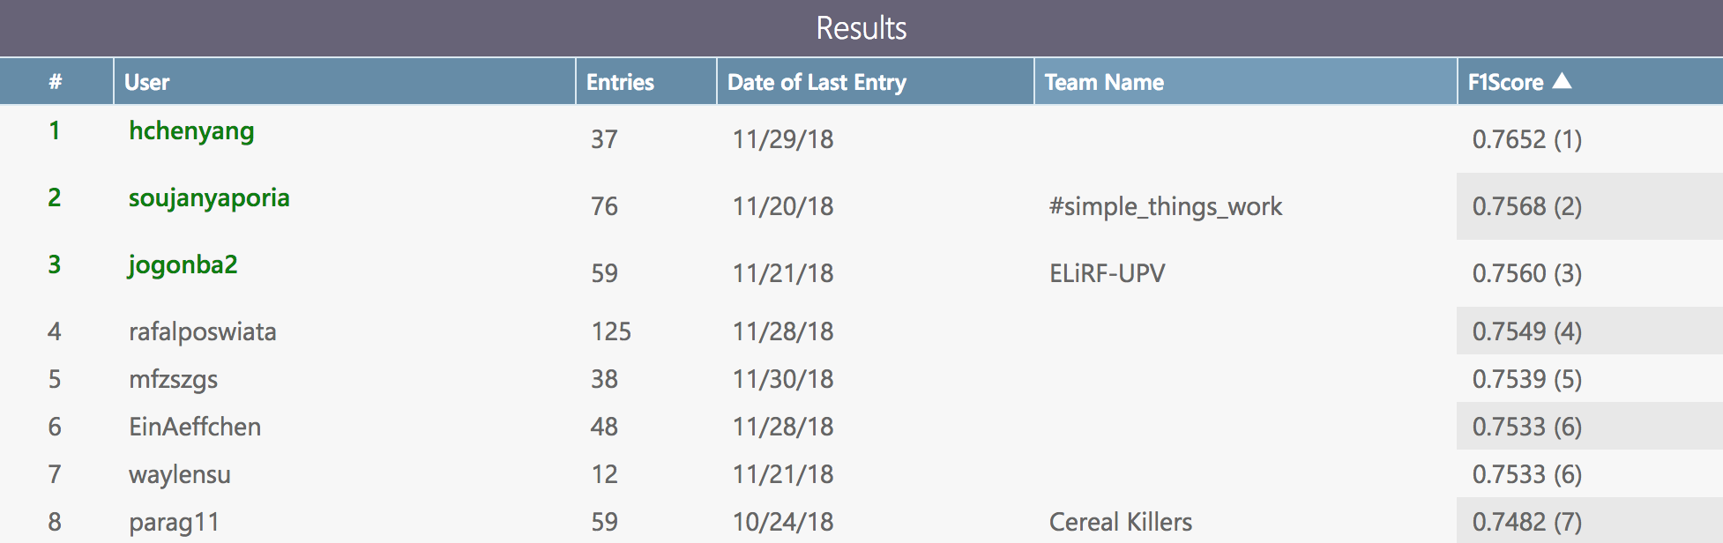
Results

